Slide 1
DISTRIBUTED PRODUCTION OF METHANOL
Vikram Rao
Research Triangle Energy Consortium
June 13, 2017

Slide 2
DISTRIBUTED PRODUCTION OF FUELS
MAKES SENSE IF
Raw material is highly distributed
OR
Fuel use points are highly distributed

Slide 3
DISTRIBUTED RAW MATERIAL
Shale gas: highly distributed
50 – 100 times smaller than conventional
Gas associated with shale oil
Median < 50,000 scfd in Bakken
Biogas from waste water treatment
50-100 thousand scfd
Uses methanol for denitrification: closed loop
Biogas from animal waste impoundments
100,000 to 1 MM scfd

Slide 4
DISTRIBUTED FUEL USAGE
Methanol for blending with gasoline
Methanol for boats
DME for trucks, trains and LPG blending
Hydrogen for automobiles

Slide 5
NEED SMALL SCALE GAS TO FUELS
Liquids transportable even in small volumes
Challenges the orthodoxy in chem. engineering
Replacing economies of scale with economies of mass production and better catalysts
Jobs distributed, not concentrated at ports
Reduces pipeline infrastructure

Slide 6
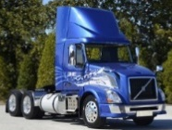
“Just-in-Place” Manufacturing
Mass Manufacture and Scaling by Numbers
Cost reduction from producing large numbers
Units could be short lived
Small Unit Size
Centralized (clustered) or distributed deployment
Locate close to raw material or market demand (DME for trucks)
Fast Deployment and Replacement
Reduce business risk, and risk of obsolescence

Slide 7
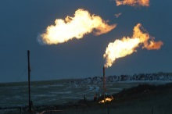

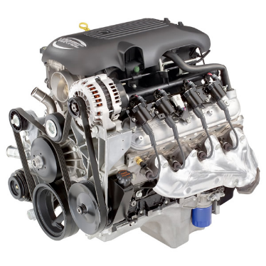
Engine-based Reformer
Flexible Feedstock
Syngas Generation
Flexible Product Slate
Methanol
RTI 10 bbl/day unit
Flared Gas, Stranded Gas, Bio-gas
FT Liquids
Clean Up
Conditioning
Compression
Olefins
Oxidant
Air
Enriched Air
Oxygen
Ammonia
Balance of Plant
Controls
Hydrogen
Filling stations
The engine is the key enabler for these technologies
Methanol is the simplest molecule to produce

Slide 8
Syngas composition as function of equivalence ratio

Slide 9
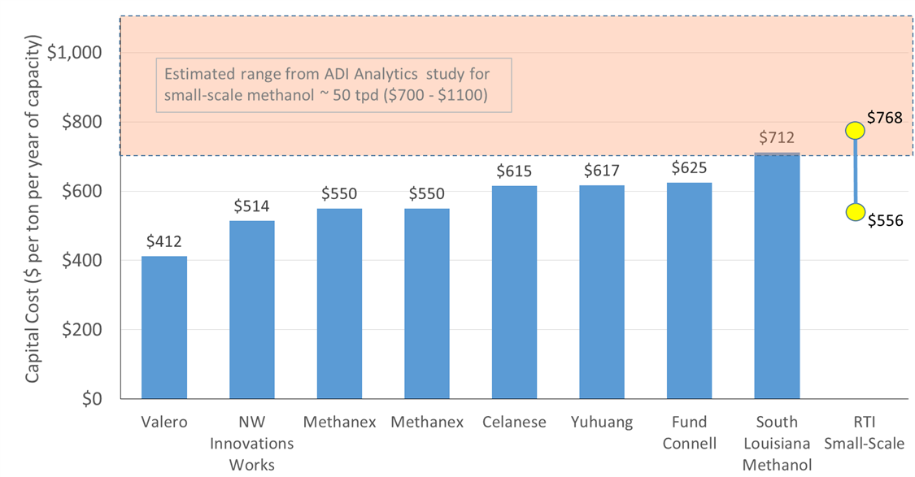
Can Small-Scale Systems be Competitive?

Slide 10
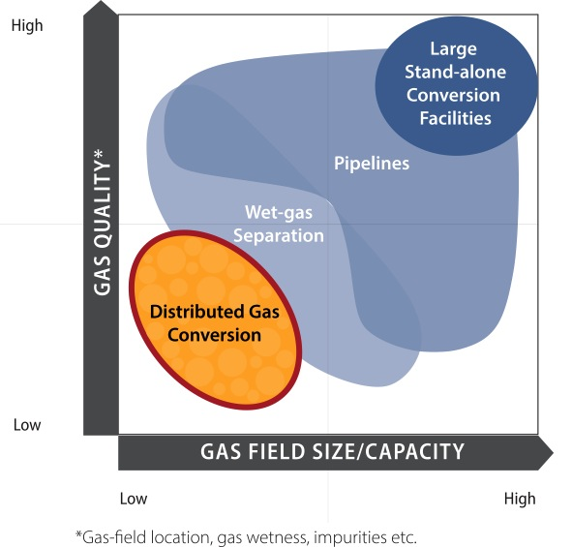
Horses for Courses One size does not fit all

